Slide 1
Stellar Evolution

Slide 2
Introduction
Stellar evolution is the process by which a star changes over the course of time. Depending on the mass of the star, its lifetime can range from a few million years for the most massive to trillions of years for the least massive, which is considerably longer than the age of the universe. All stars are formed from collapsing clouds of gas and dust, often called nebulae or molecular clouds

Slide 3
Resources
OpenGL
GLUT
C

Slide 4
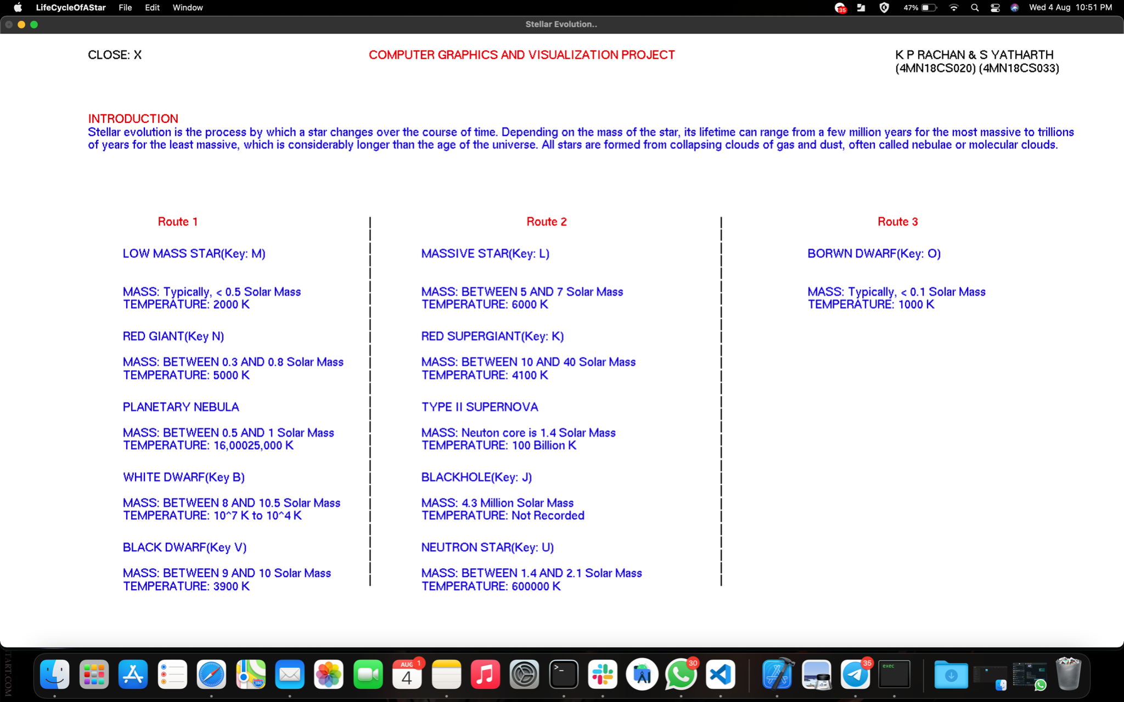

Slide 5
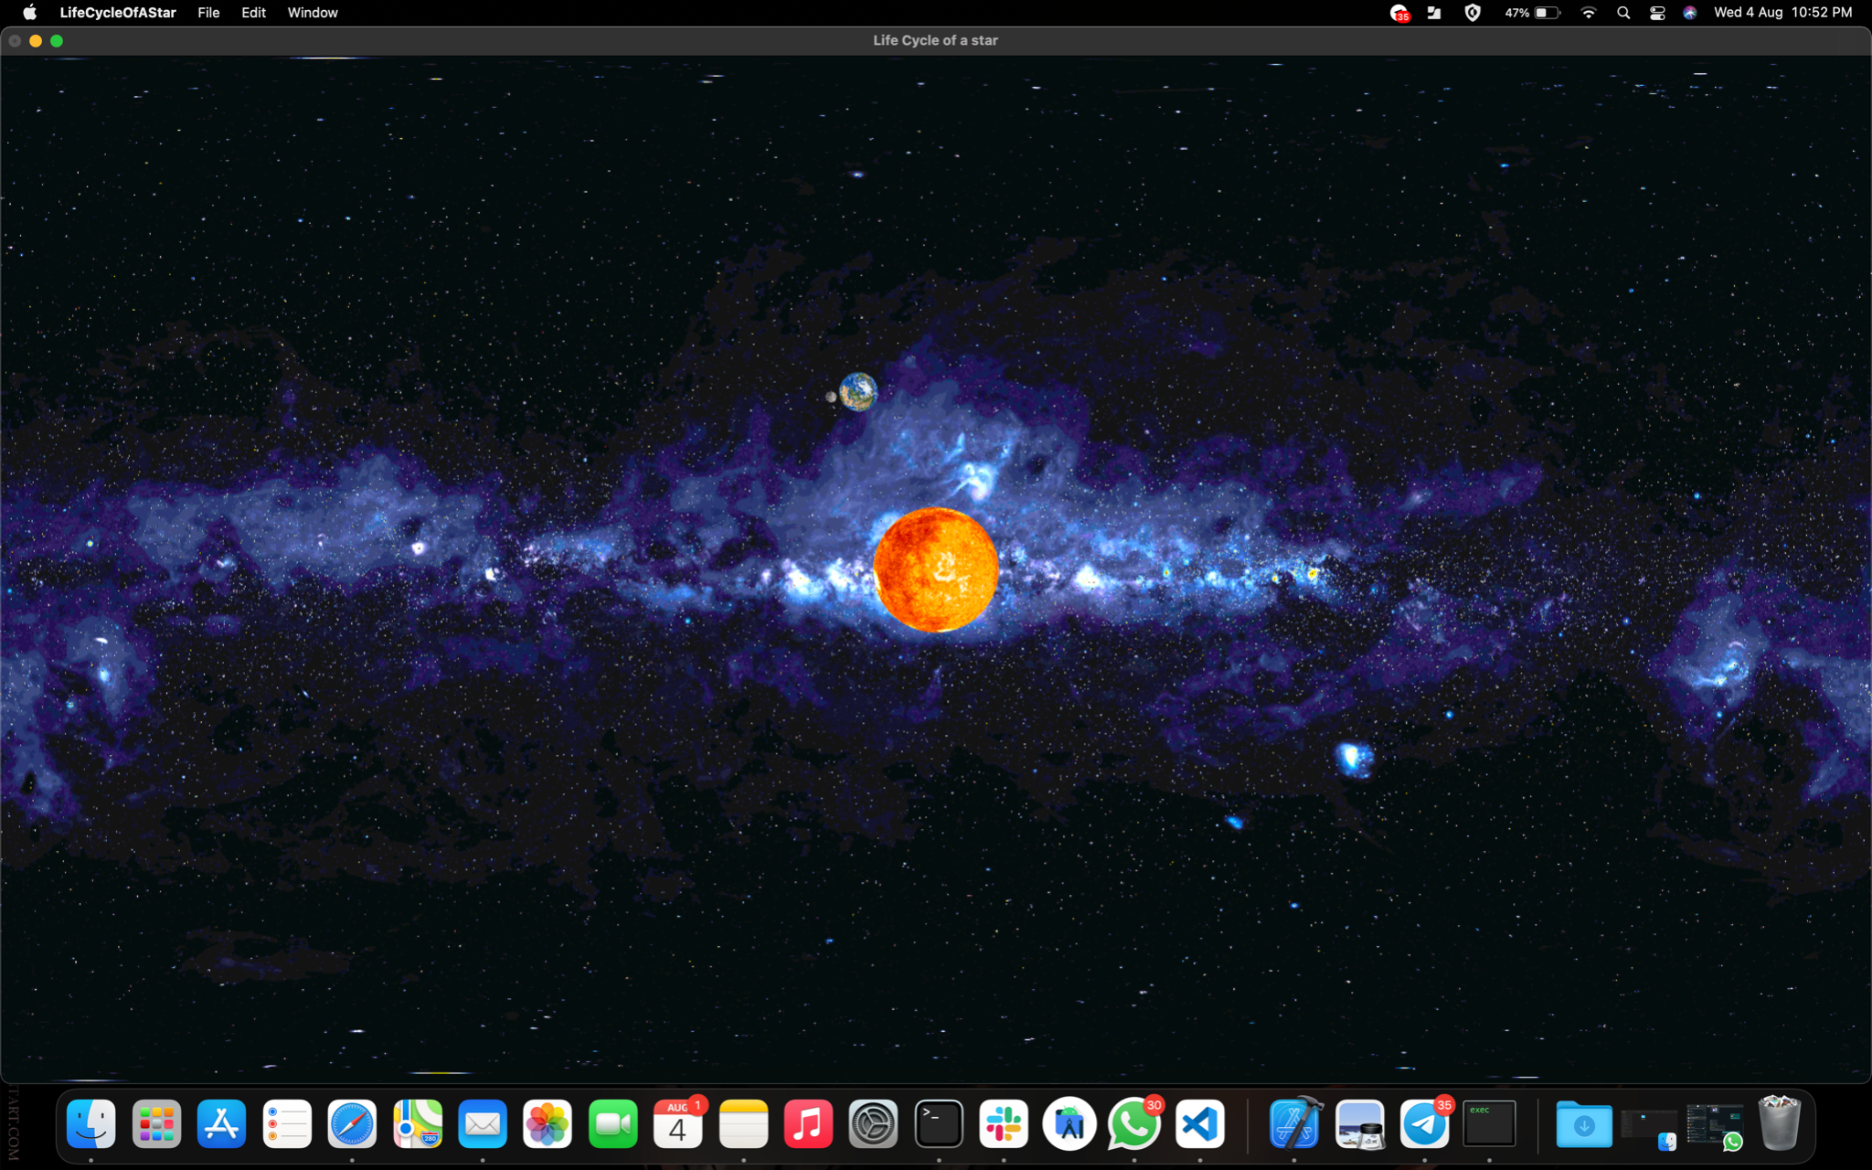

Slide 6
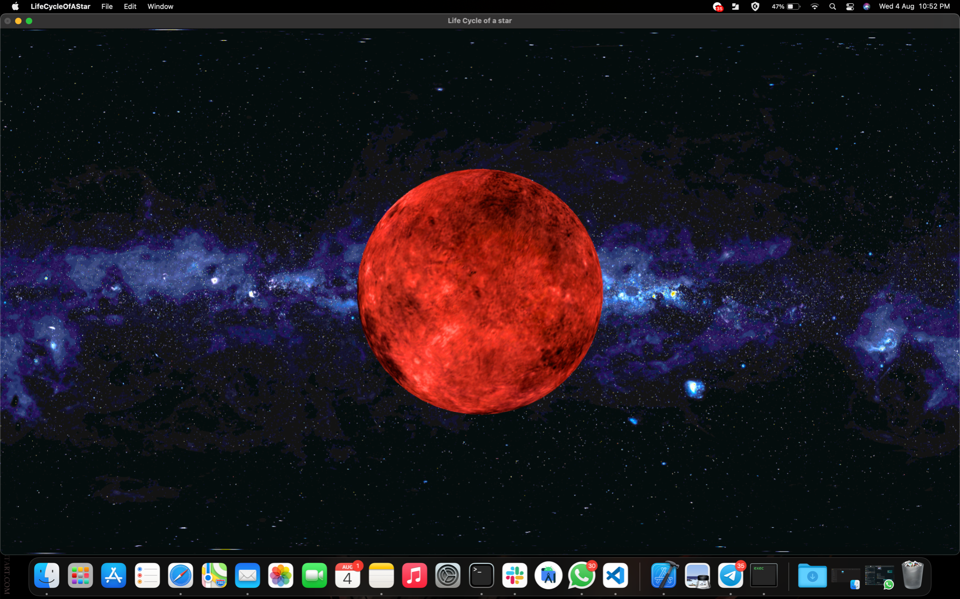

Slide 7
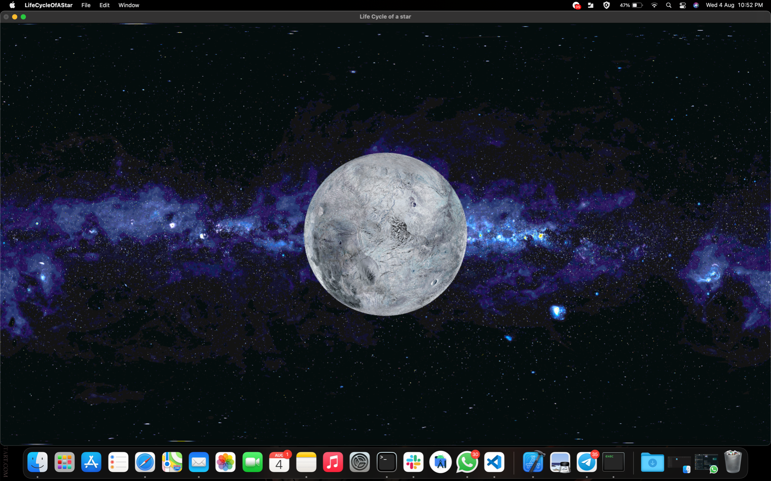

Slide 8
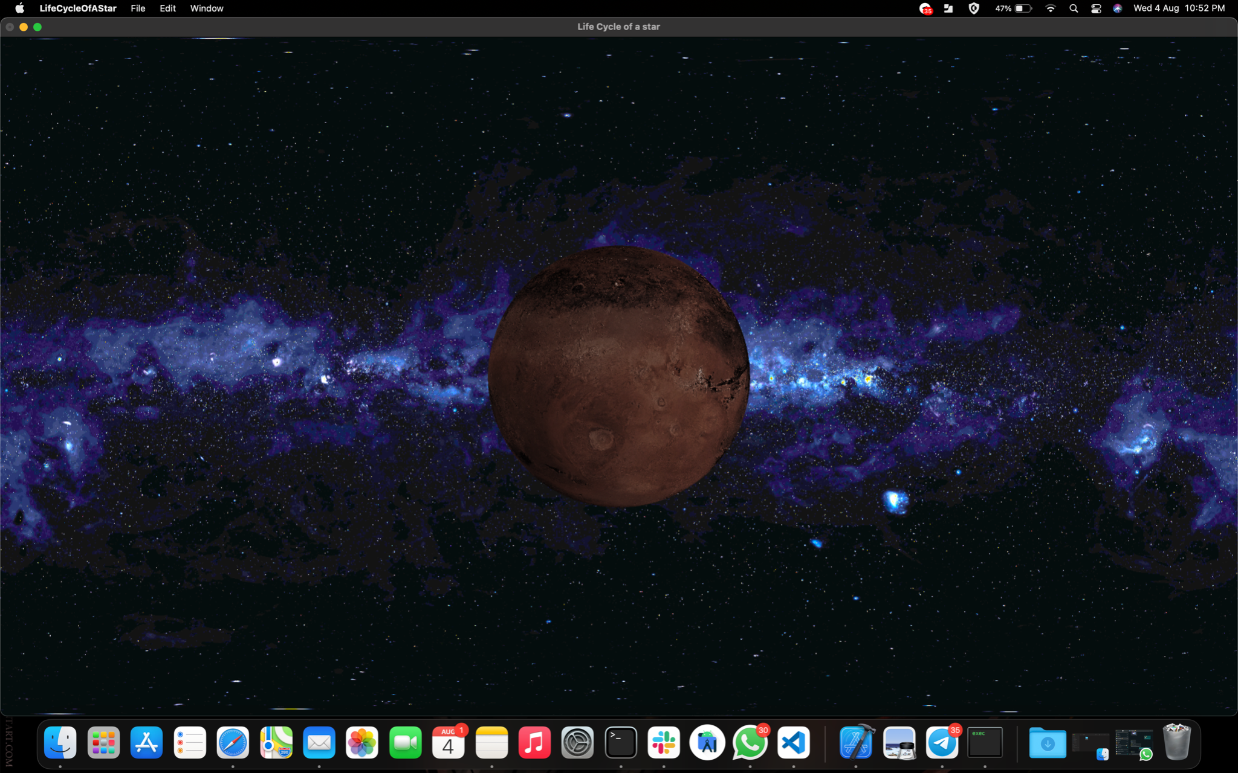

Slide 9
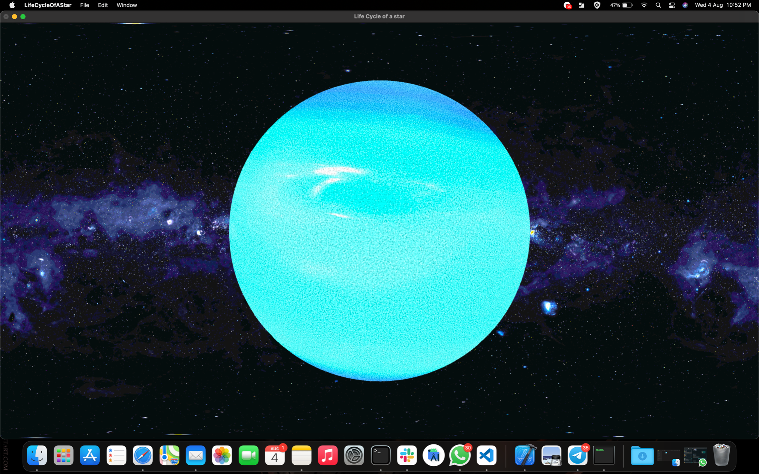

Slide 10
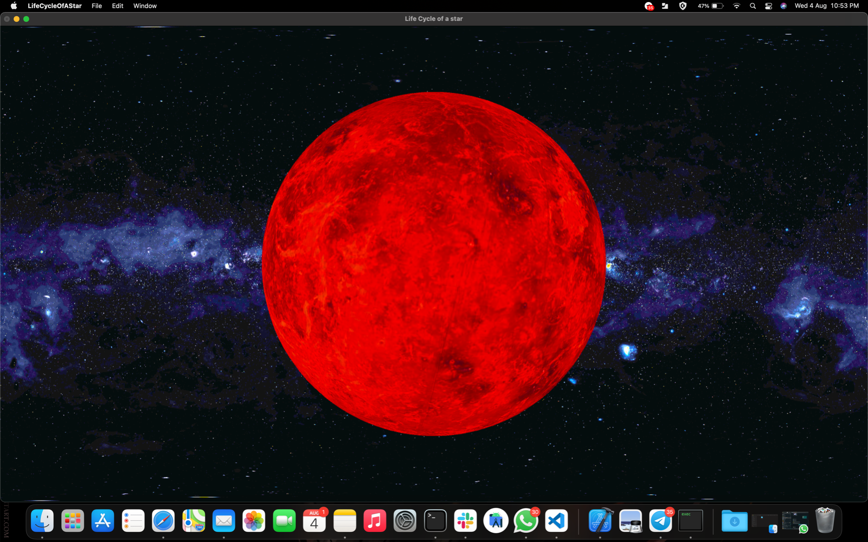

Slide 11
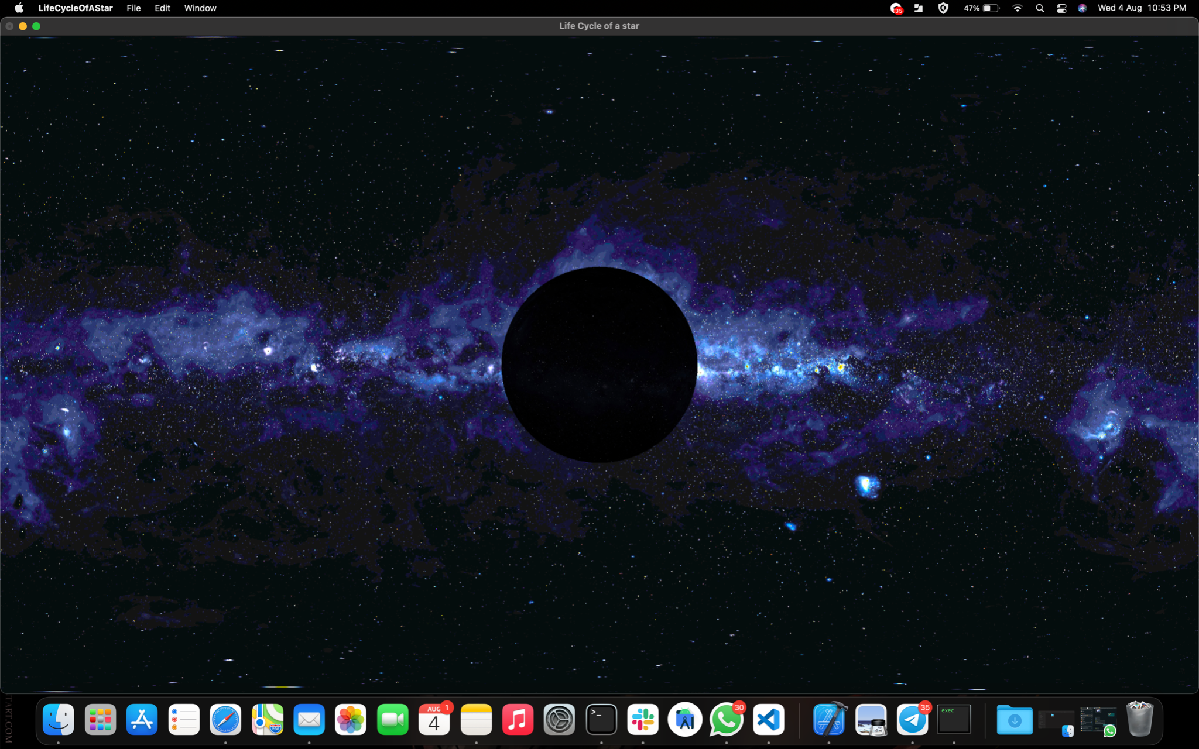

Slide 12
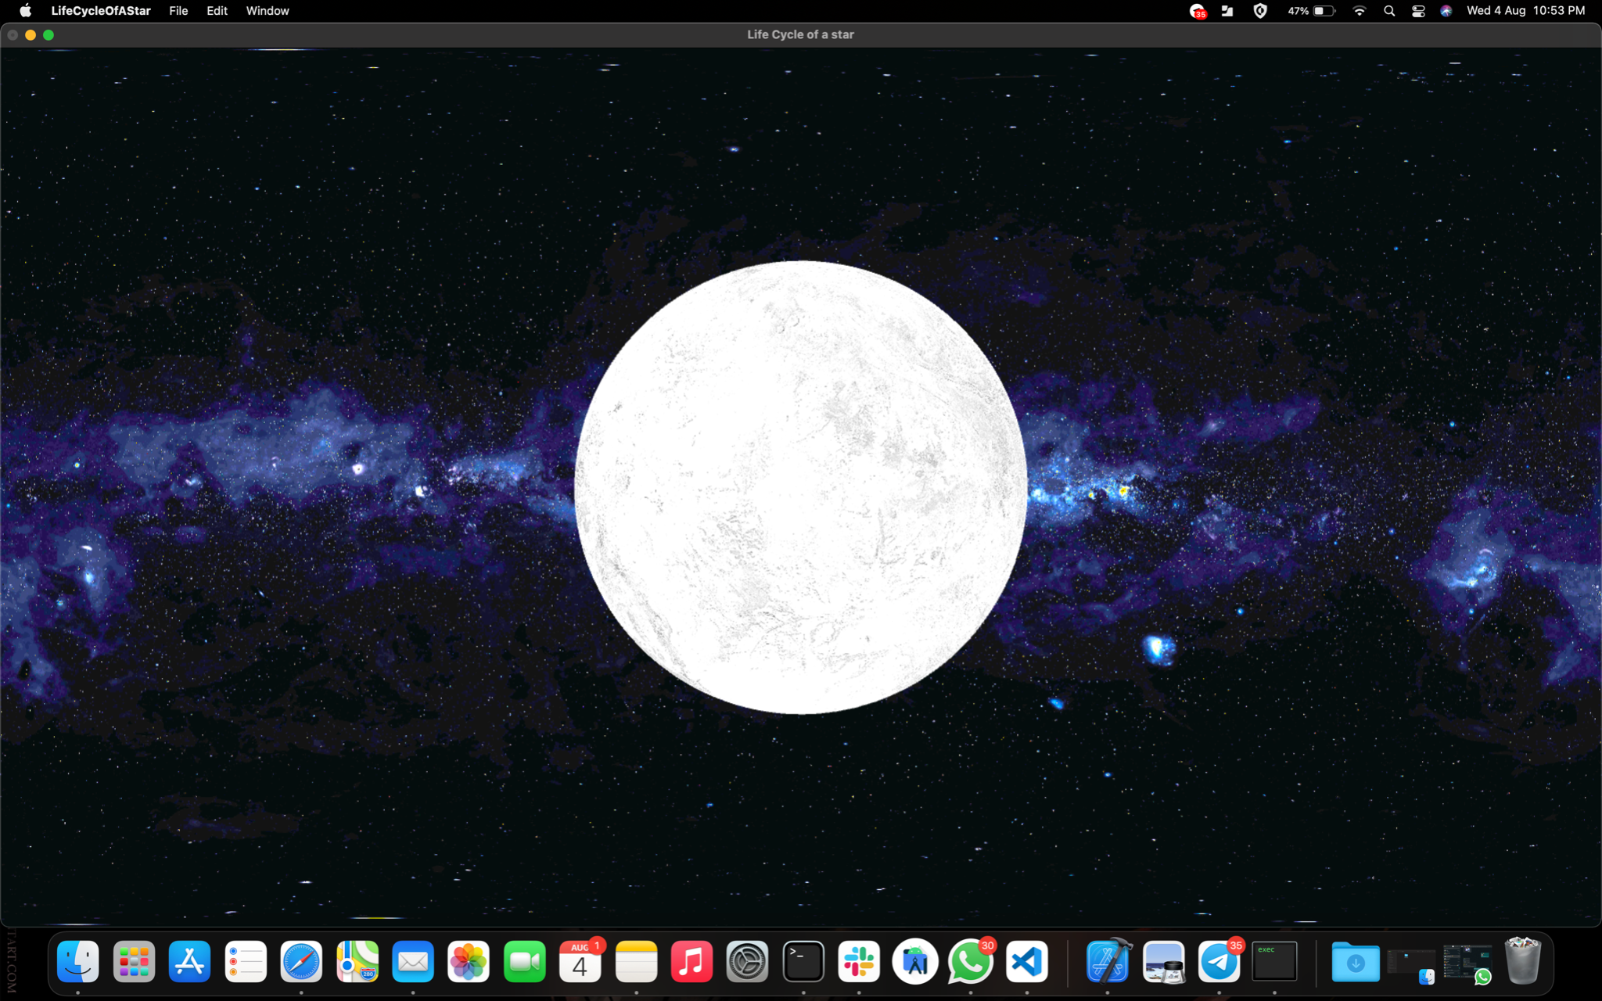

Slide 13
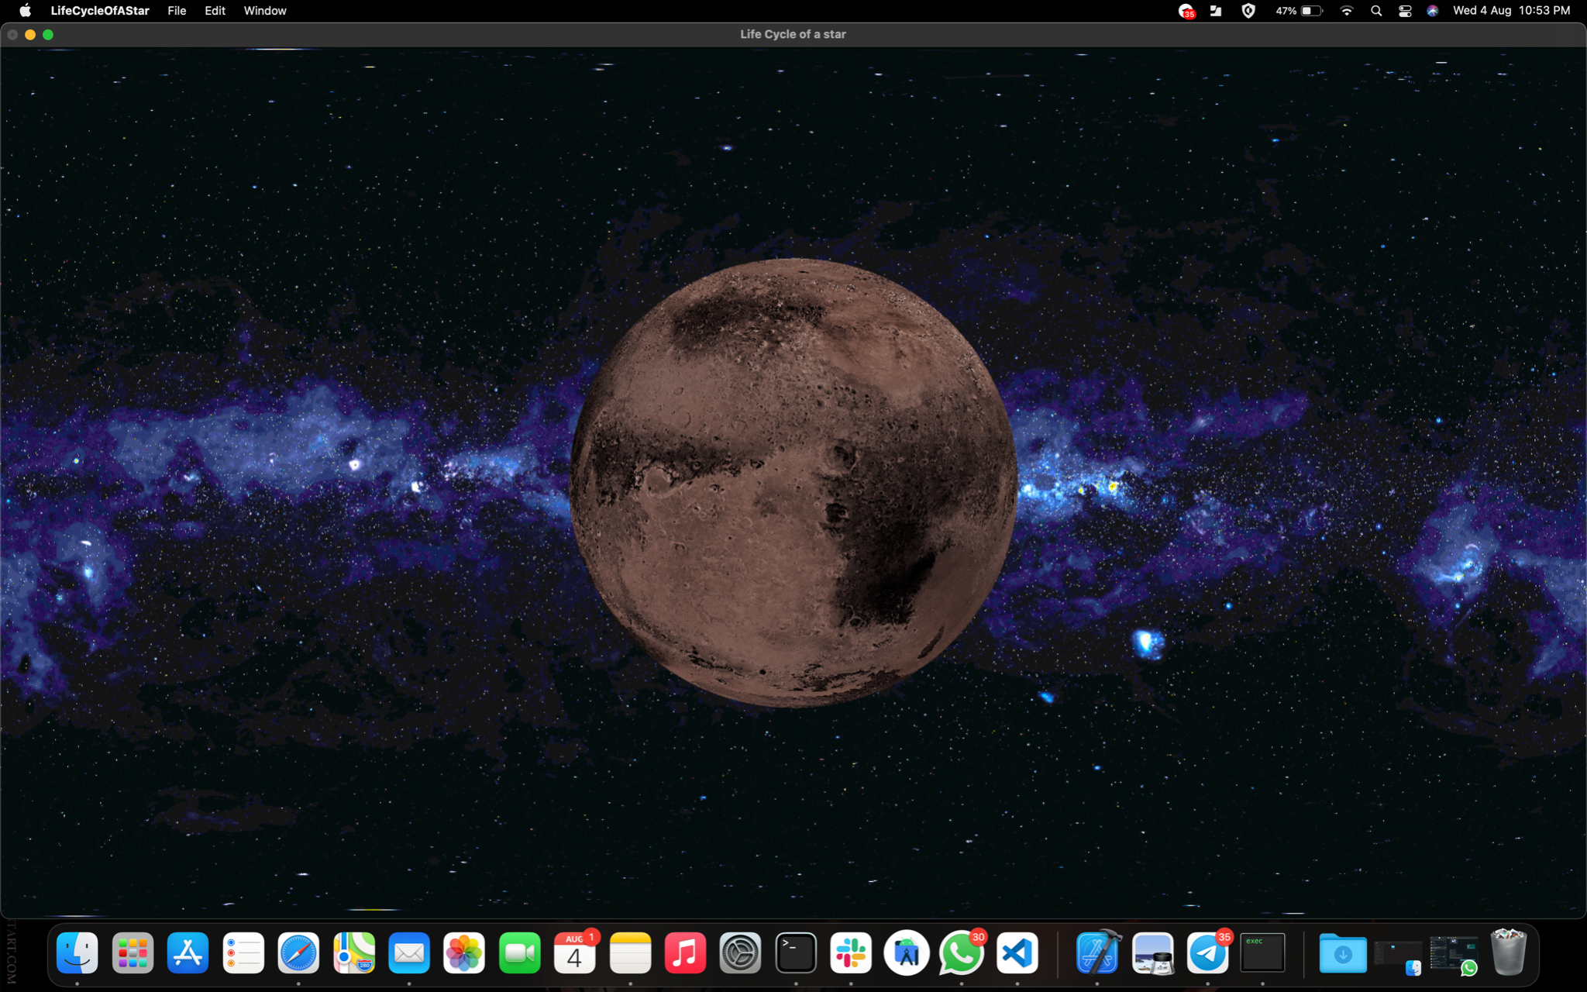

Slide 14


Slide 15
Thank you
S Yatharth (4MN18CS033) K P Rachan (4MN18CS020)
GUIDED BY: PROF. BHARATH BHARADWAJ B S

